Slide 1
Child Monitoring System
FYP Presentation:
By: Santhosh Kanaga Sabapathy
Notes:
Good afternoon Dr.Grace Dr.Haider today I will be presenting my final year project the child monitoring system.

Slide 2
Table of Contents
Introduction
Literature Review
Methodology
Result and Analysis
Conclusion
References
Notes:
Slide 2 shows the table of contents starting with the introduction where I will be talking about the problem statement and the aim and objectives of the project. Moving onto Literature review where I will be giving some examples of similar iot projects. Then the methodology where I will be talking about how the project is be conducted. Continuing to talk about the outputs achieved in the results and analysis section. And finally going through, conclusion and reference.

Slide 3
Introduction

Slide 4
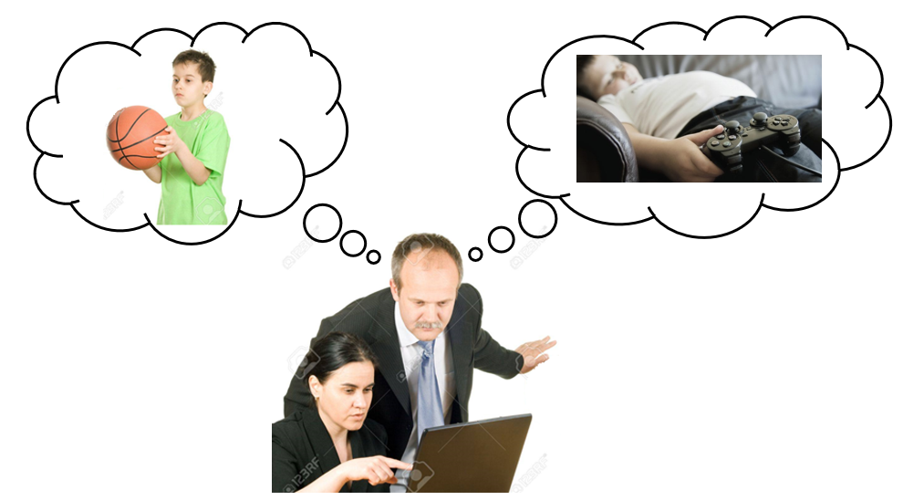
Problem Statements
Parents are only relived only when the know when their child is safe.
As the world is rapidly developing the number of children living in cities are significantly increasing.
Busy working parents usually don’t have enough time to look after their children.
Figure 1: Parent thinking about child when working
Notes:
Starting off with the introduction: the problem statement
Parents can only be satisfied when they are assured that the child can grow in a safe environment and to be convinced that the child is healthy and protected. As the world is rapidly developing the number of children living in cities are significantly increasing.

Slide 5
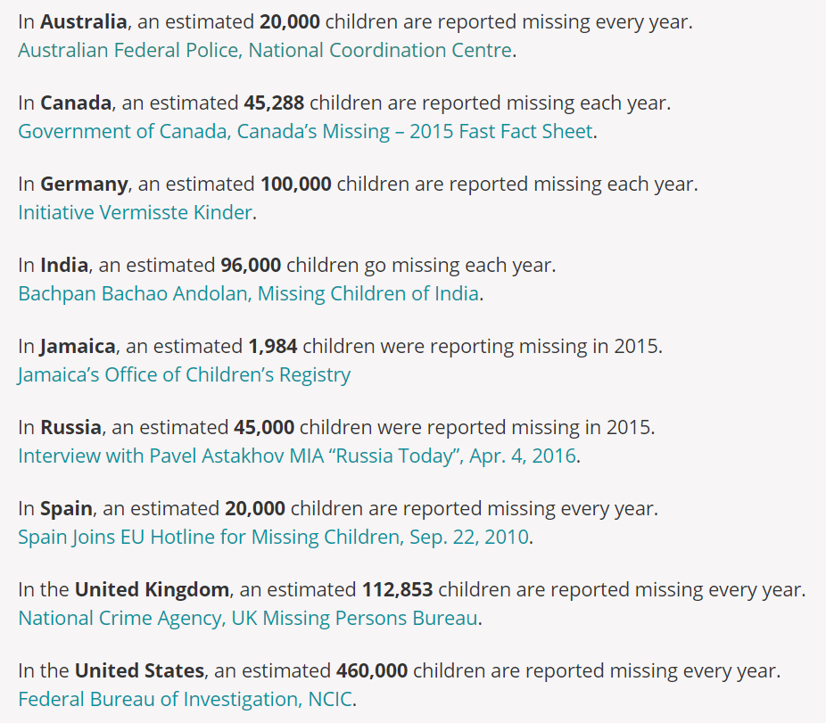
Problem Statements
Figure 2: Global Missing Children Network [1]
A report by the World Health Organization concludes 80% of children between the ages of 11 and 17 aren’t physically active enough [2].
Notes:
From the global missing children network website Figure 2 shows the estimate of missing children per year in some of the countries .As you can see UK has estimated about 110,000 children missing every year and United States which is approximately 4 times of that.
Missing children isn't the only concern for parents.
A report by the World Health Organization concludes 80% of children between the ages of 11 and 17 are not physically active enough. This also brings concern to the health aspect for the child
But busy parents cannot be monitoring the child's activity 24/7 in this busy fast pacing world.
Hence This project has been conducted to overcome some of these worries.

Slide 6
Aim and Objectives
Aim
To design and develop a child monitoring system.
Objectives
To develop a device that gathers and transmits data from child through Wi-Fi.
To develop a mobile application to show child status.
Statuses of child to be represented using different Led on the Lamp.
Notes:
The aim of this project is to design and develop a system That helps parents to monitor the activities of their child.
And the objectives are to develop a device that gathers and transmits data from the child. And develop a mobile application for the parents to easily view the child status .and finally make a Lamp which represents the child status through differrent colors when Parent is at home.

Slide 7
Literature Review

Slide 8
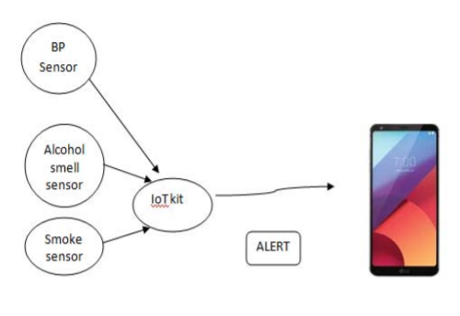
Literature Review
Hybrid Model on Child Security and Activities Monitoring System [3]
It monitors alcohol and smoke levels surrounding the child
A blood pressure sensor is added to check weather the child is in any abnormal conditions.
Figure 3: Hybrid model for Child Security
Notes:
Moving on to the literature review here are some similar iot based monitoring system projects
Hybrid model on child security and activity is a monitoring system that monitors alcohol and smoke level surrounding a child. The system consists of a smoke sensor alcohol smell sensor and a blood pressure sensor to check whether the child is in any abnormal condition. If the child is in danger the parent will receive a notification on their phone regarding it. Figure 3 shows a model of this monitoring system.

Slide 9
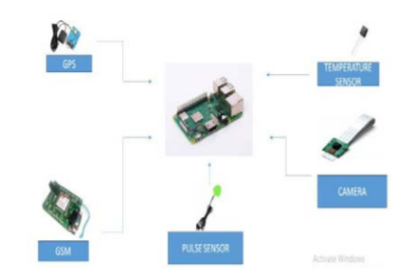
Literature Review
Child Safety Monitoring System Based on IoT [4]
Consists of many different sensors to monitor the child.
A specific boundary is set, and if the device leaves the boundary the parent/guardian receives a call.
Live location can be seen after user logs on to the application.
Figure 4: Architecture diagram of the system
Notes:
Child safety monitoring system based on iot this project consists of many different sensors to monitor the child. the sensors include Temperature sensor pulse sensor a camera GSM module and a GPS module. For this project a specific boundary is set around the device and if this device leaves the premise parents will be notified Through an application
and furthermore this module can take child’s Temperature and pulse readings. Figure 4 shows How the modules are connected in the system.

Slide 10
Methodology

Slide 11
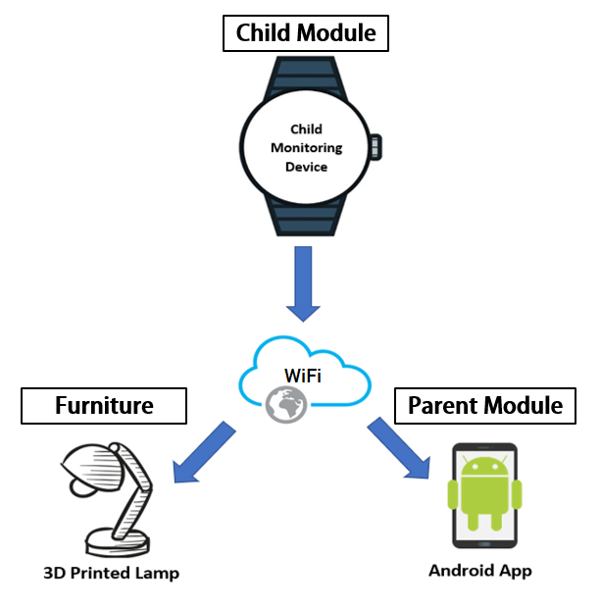
Methodology
The system developed consists of three main parts:
Child Module
Parent Module
3D Printed Wi-Fi Lamp
And these three parts are interconnected using Wi-Fi.
Figure 6: Basic Representation of System
Notes:
Now let us look at the methodology of this project. the system consists of three main parts the child module the parent module and the 3D printed by WIfi lamp and all these modules are interconnected using a local area network. figure 6 show us a basic representation of this system.

Slide 12
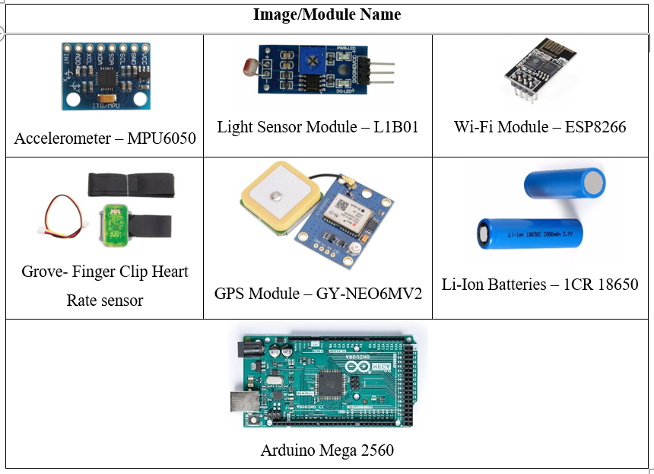
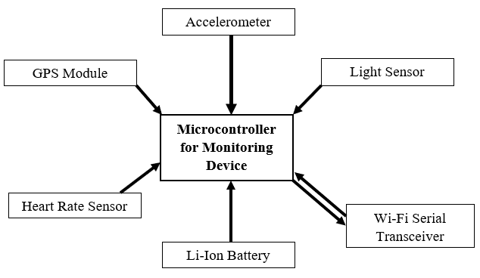
Methodology
Child Module
It involves various number of sensors that gather data from the child.
Sends the data collected to the Parent Module.
Figure 7: Block Diagram of the Child Module
Figure 8:Components of the Child Module
Notes:
Let's start by looking at the child module This module is attached to the child and it involves various number of sensors which gather data from the child such as location and activity of the child. After gathering required data, it sends this data to the parent module when required. the devices used in this module are an accelerometer a light sensor a Wi-Fi module a heart rate sensor A GPS module and an Arduino mega as the microcontroller further Lithium ion batteries are added to make the system portable. Figure 7 shows the block diagram of the child module and Figure 8 shows the components used.

Slide 13
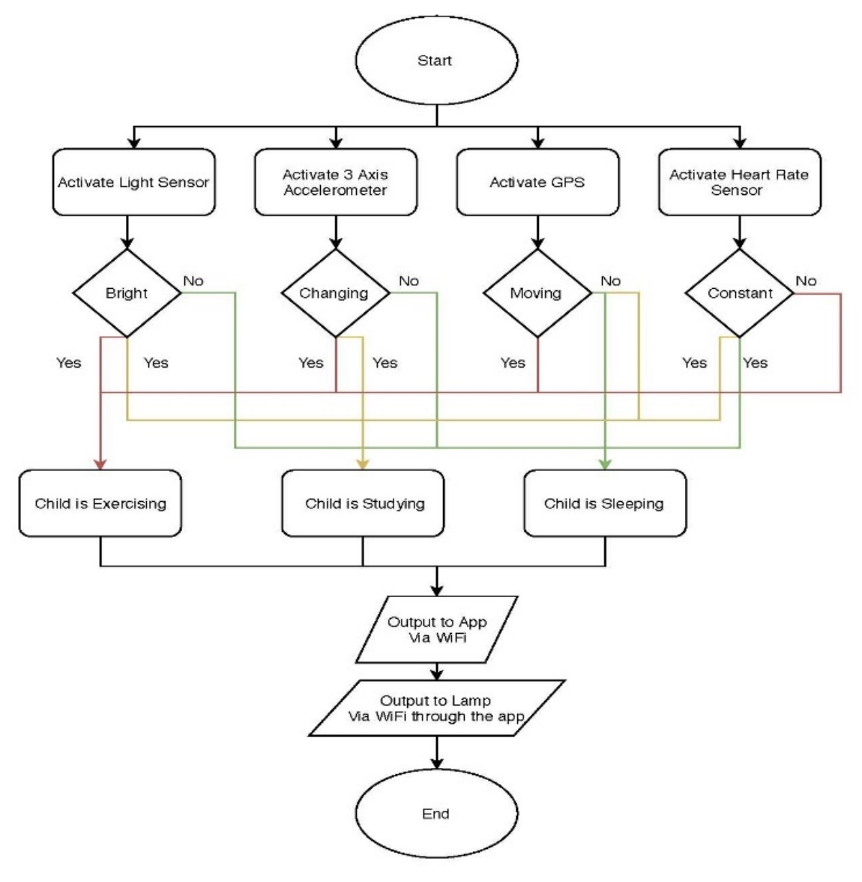
Methodology
Child Module: How it Works
4 sensors work together to determine one of the three activities the child is doing.
Exercising
Studying
Sleeping
Figure 9: Flow Chart of the Child Module
Notes:
So how does it actually work the four sensors which are the light sensor the accelerometer the GPS module and Pulse sensors act together to determine one of the three activities the child is doing the activities involved are exercising studying and sleeping. Figure 9 shows a flow chart of how this works.

Slide 14



Methodology
Child Module
Figure 10: Child Sleeping
Figure 11: Child Exercising
Figure 12: Child Studying
Notes:
The table on slide 14 displays a more convenient way to look at this.
The activity is sleeping if the light sensor Detects no light the accelerometer is not moving, and the GPS is in the same position and the heart rate is constant.
It will show exercising if the light sensor detects light the accelerometer is constantly moving GPS is moving and when heart rate is not constant
And finally studying when light sensor detects light the accelerometer is moving GPS is in the same position and the heart rate is constant

Slide 15
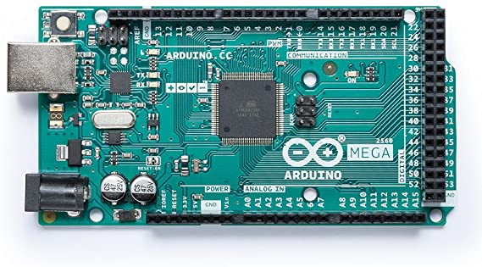

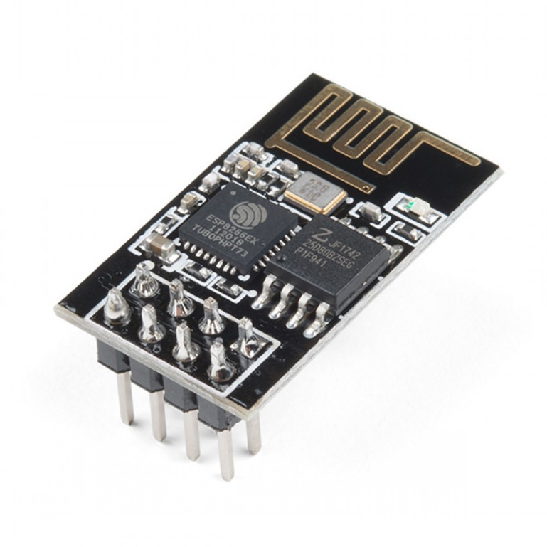

Methodology
Parent Module
This is an Application module that will be used by the parents to monitor the child
It represents data from the webpage that is received from the Child Module
Represents the data in an organized manner
Child Module Sensor Data
Wi-Fi Module
Webpage
Android Application
Figure 13: Representation of Data Transmission to the App
Notes:
Moving on to the parent module This module is an Android application that gets data from the child module. It reads the data and represents it in an organized manner which is easy for the parent to read and understand
How this works is after the Arduino mega gets data from the Sensors it transmits it to a website using the Wi-Fi module and mobile application is used to display information from the web page.

Slide 16

Methodology
3D Printed Wi-Fi Lamp
This is a 3D printed Furniture
It changes color according to child’s activity status
Also gets data from child module through Wi-Fi
Child Module Sensor Data
Wi-Fi Module
3D Printer Lamp
Figure 14: Representation of Data Transmission to the Lamp
Notes:
Finally the 3D printed Wi-Fi lamp Will be a furniture that is kept in the house which changes color according to the activity the child is engaged in, so that parents don't always have to check their phone to see the child’s status. How this works is Similar to the parent module, after Gathering child’s data It is transmitted to the lamp using the Wi-Fi module. The lamp also consists off microprocessor and a Wi-Fi module to receive the data.

Slide 17
Result and Analysis

Slide 18
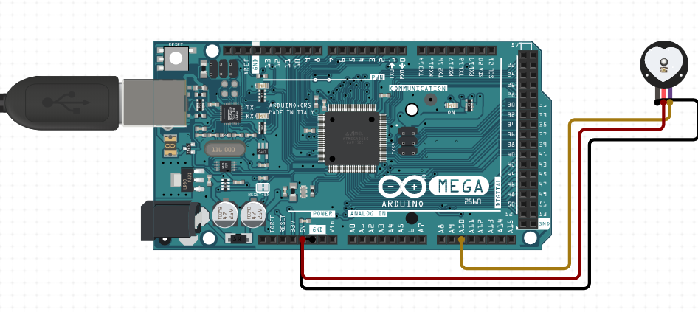
Result and Analysis
Child Module: Heartrate Sensor
Kids' heart rates can be as low as 60 beats per minute during sleep and as high as 220 beats per minute during strenuous physical activity.
Hence, programming the sensor to output
‘Sleeping’ when heart rate is
>50 to <70 beats/minute
‘Studying’ when heart rate is
>70 to <150 beats/minute
‘Exercising’ when heart rate is
>150 to <230 beats/minute
Figure 15: Connections of Heart Rate sensor
Notes:
Due to the lock down all The Sensors could not be made to work together hence here each sensor Is used separately to show the activity.
Starting with the heart rate sensor. Research shows that kids heart rate can be as low as 60 beats per minute during sleeping and as high as 220 beats per minute during physical activity. Using this the heart rate sensor is Programmed to output sleeping when the heart rate is more than 50 and less than 70 beats per minute. similarly studying when heart rate is more than 70 and less than 150 beats per minute and finally exercising when heart rate is more than 150 and less than 230 beats per minute. Figure 15 shows the connection of the heart rate sensor

Slide 19
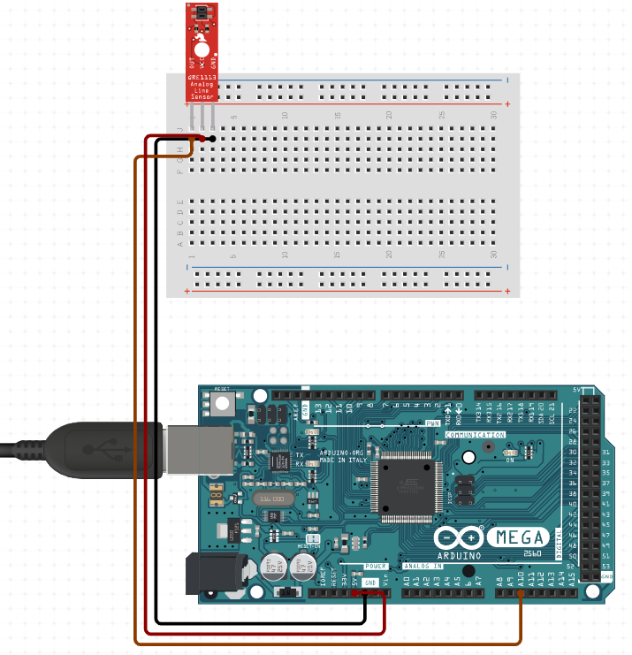
Result and Analysis
Child Module: Light Sensor
The function of the light sensor is to decide if the child is sleeping or awake.
The light sensor sends a
‘High’ when it detects light
‘Low’ when no light is detected
Figure 16: Connections of Light Sensor
Notes:
The light sensor is programmed to decide if the child is sleeping or awake. hence it decides child is sleeping when there is no light and child is awake when it detects light. Figure 16 shows connections of the light sensor

Slide 20
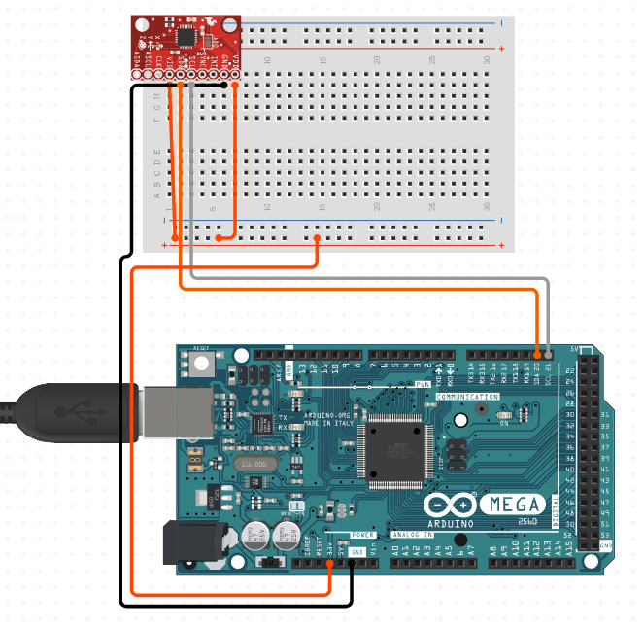
Result and Analysis
Child Module: MPU Module
The MPU is used mainly to decide if the child is exercising or resting.
If the MPU detects continues change on
>2 of the 3 axis then turns ‘High’
<2 of the 3 axis then turns ‘Low’
Figure 17: Connections of MPU Module
Notes:
The MPU module is used mainly to decide if the child is exercising or resting. this is done by detecting if the MPU continues to change in more than one axis. So if there is continuous change in 2 or more of the axis of the MPU then the child is exercising And if there is change in less than two axis’s of the MPU then the child is considered resting. Figure 17 shows the connections of the MPU module.

Slide 21
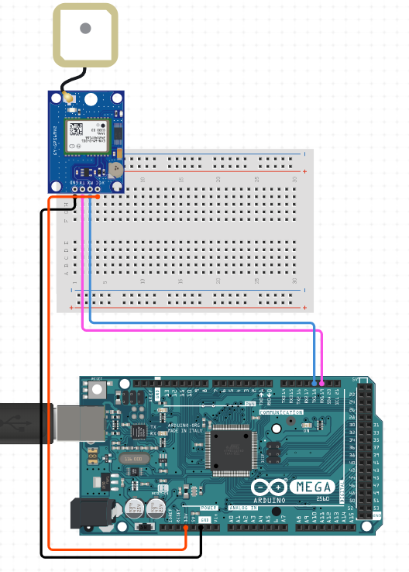
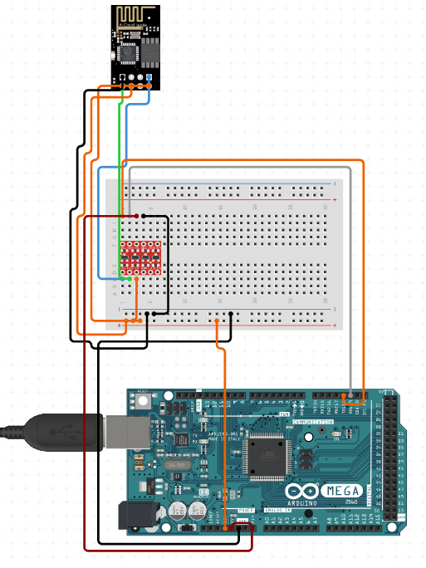
Result and Analysis
Child Module: GPS and Wi-Fi Module
The GPS module is used to locate the child at any time by providing parent with the coordinates of the child.
Figure 18: Connections of Wi-Fi Module
Figure 19: Connections of GPS Module
Notes:
The GPS module is used to locate the child at any time by providing parents with the coordinates of the child on the mobile app and the Wi-Fi module is used to send the data to the webpage. How this works When the Wi-Fi module is connected to the LAN it creates a web page using the LAN IP so this webpage will display the activity of the child. Figure 18 and 19 shows the connections of the Wi-Fi module and the GPS module.

Slide 22
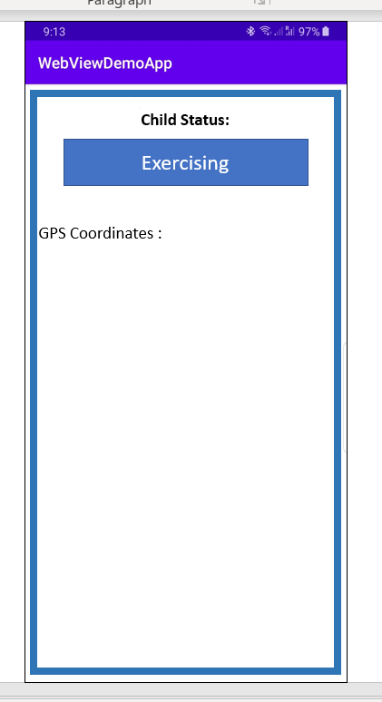
Result and Analysis
Parent Module
The android application represents the data that is displayed on a webpage
The Webpage was created using HTML
The application was created using Java in Android Studio
Figure 20: Layout of the Android Application
Notes:
Coming to the parent module, The Android application represents the data that is displayed on a web page. The web page was created using HTML on the Arduino IDE. and the application was created using Java on Android studio. figure 20 shows the layout of the Android application.

Slide 23
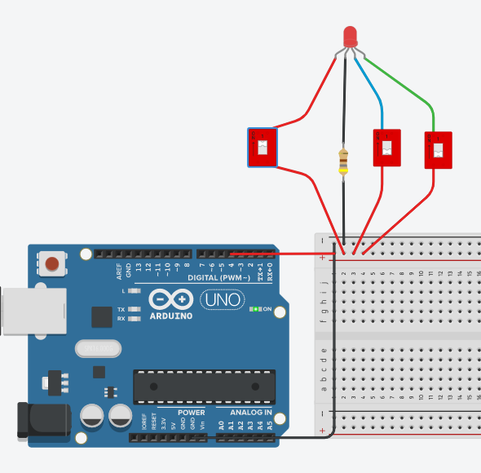
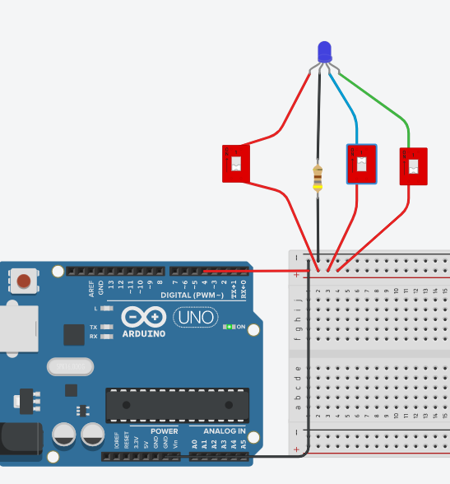
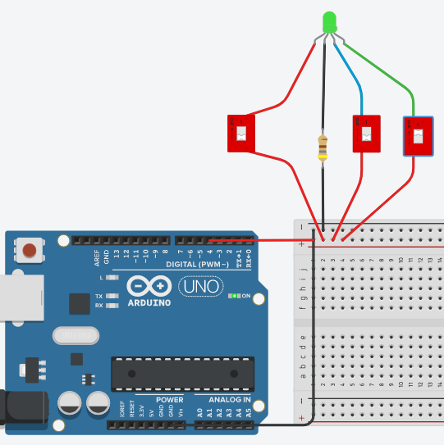
Result and Analysis
3D printed Wi-fi Lamp
A simulation was created for the Lamp
Figure 21: Red Light when Exercising
Figure 22: Blue Light when Sleeping
Figure 23: Green Light when Studying
Notes:
And finally coming to the 3D printed Wi-Fi lamp a simulation was created that would show different colors for the different activities the child is engaged in. as shown on Figure 21, 22 and 23. Red light when child is exercising, blue when sleeping and green when studying.

Slide 24
Conclusion

Slide 25
Conclusion
The aim and objectives of project were achieved.
Limitations:
product size is too big.
only work within local area network.
Every parent would want to take good care of their child even when they are busy. Hence considering this project it makes it easy for parents to track and monitor the child's health on a regular basis which will make them ensure the safety of their child.
Notes:
Lastly moving on to the Conclusion the overall aim and objectives of the project were achieved But they do have some limitations for example the product size Is too big so it will be difficult moving Around when attached to the child .and the system only works within a local area network.
Compared to other projects this project shows that the child is healthy and safe, and this Makes it easy for parents to track and monitor the health and safety of the child.

Slide 26
References
[1] “Missing Children’s Statistics”. globalmissingkids.org
https://globalmissingkids.org/awareness/missing-children-statistics/#
[2] Matt Berger. “Children Worldwide Aren’t Getting Enough Exercise”. Helthline.com
https://www.healthline.com/health-news/children-around-the-world-dont-get-enough-exercise
(assessed Nov. 20, 2019)
[3] R. Kamalraj, “A Hybrid Model on Child Security and Activities Monitoring System using IoT,” Inventive Research in Computing Applications, 2018, pp. 996 – 999.
[4] N. Senthamilarasi, N.Divya Bharathi, D.Ezhilarasi, R.B.Sangavi, “Child Safety Monitoring System Based on IoT,” Physics and Photonics Processes in Nano Sciences, 2019, pp. 1 -7.
Notes:
Slide 26 shows some of the reference used in this presentation.

Slide 27
Thank you
Notes:
This comes to the end of the presentation thank you for your time.

